Slide 1
NAME : VISWAACSENAR J
REG NO : 23CS131
SUBJECT :ADVANCED JAVA PROGRAMMING
TOPIC : INTRODUCTION TO JDBC

Slide 2


INTRODUCTION TO JDBC
JDBC, or Java Database Connectivity, is an API that allows Java applications to interact with a variety of databases. Understanding JDBC is essential for advanced Java programming, enabling developers to connect, execute queries, and manage database records effectively.

Slide 3

Overview of JDBC
What is JDBC?
JDBC stands for Java Database Connectivity, which provides a standard interface for connecting Java applications to databases, facilitating data exchange and manipulation.
Importance of JDBC
JDBC enables Java developers to build robust applications that require database interaction, serving as a bridge between Java applications and various relational databases.
Core Components
The JDBC API comprises two main packages: java.sql for core functionalities and javax.sql for advanced features like connection pooling.

Slide 4


JDBC Architecture
1
Two-Tier Architecture
Client communicates directly with the database server, with JDBC drivers managing the interaction.
2
Three-Tier Architecture
An intermediate server handles requests between the client and the database, enhancing scalability and security.
3
Driver Types
Four types: type-1 (JDBC-ODBC bridge), type-2 (Native-API), type-3 (Network Protocol), and type-4 (Thin driver).

Slide 5



Utilizing JDBC for Database Operations
JDBC, or Java Database Connectivity, plays a crucial role in enabling Java applications to interact with databases. By establishing connections, executing queries, and processing results effectively, developers can create dynamic and data-driven applications.
Executing Queries
2
Utilize Statement and PreparedStatement to execute SQL queries.
Establishing Connections
1
Use DriverManager to connect to a database with a specified URL.
3
Processing Results
ResultSet interface allows iteration through query results.

Slide 6


Error Handling in JDBC
SQLException
Error Codes and Messages
Best Practices
Primary exception thrown by JDBC for database access errors.
Close resources in a finally block or use try-with-resources.
Understanding SQLState codes aids troubleshooting.

Slide 7




Understanding JDBC Transactions
Transaction Management
JDBC supports transaction management using methods like setAutoCommit(false), commit(), and rollback(). This allows developers to control transaction boundaries effectively.
2
What are Transactions?
A transaction is a group of SQL operations that are executed as a single unit. A transaction must either complete in its entirety or not at all, ensuring data integrity.
1
Use Cases
3
Transactions are essential in operations like fund transfers, where multiple database changes must succeed or fail together. Proper transaction management prevents inconsistent data states.

Slide 8


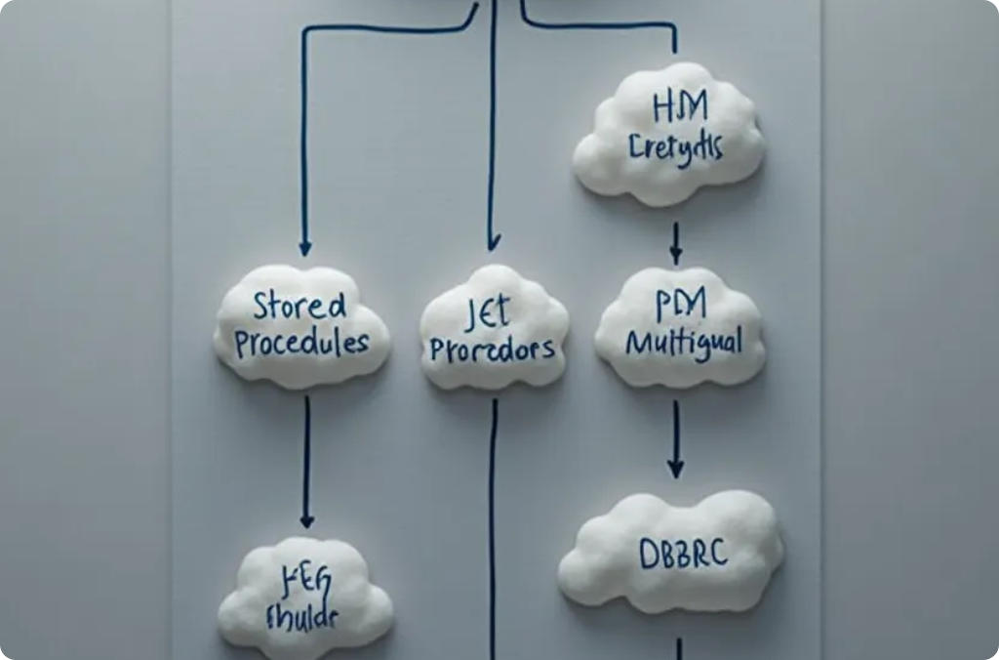
Advanced JDBC Features
Connection Pooling
Batch Processing
Stored Procedures
This technique improves performance by reusing database connections instead of opening new ones for every request.
JDBC allows executing a batch of SQL statements in a single call, reducing network round trips.
JDBC can call stored procedures, allowing developers to encapsulate complex operations within the database.

Slide 9



JDBC Best Practices
Security
Protect against SQL injection by utilizing PreparedStatement and always validate user inputs before processing.
2
Efficiency
Minimize resource usage by using connection pooling and batch updates, and ensure proper closing of resources to prevent memory leaks.
1
Logging and Monitoring
Implement logging for database operations and monitor performance metrics to identify and resolve potential bottlenecks in database interactions.
3

Slide 10

THANK YOU

